Slide 1
Electricity

Slide 2
Electricity
There are two types of charges:
Protons - positive
Electrons - negative.
The accumulation of excess charge on an object is known as static electricity. Static electricity is potential energy. It is stored.

Slide 3
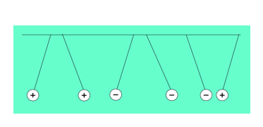
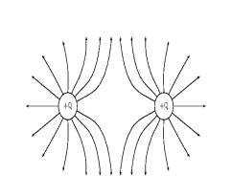
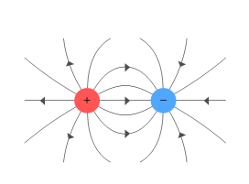
Electrical Charges
Charges exert forces
Like charges repel
Opposite charges attract
Electric Fields:
Surrounding every electric charge is an electric field that exerts forces on other electric charges.

Slide 4
Law of conservation of charge
According to this law, charge can be transferred from object to object, but it cannot be created nor destroyed. The charge simply moves from one place to another.

Slide 5
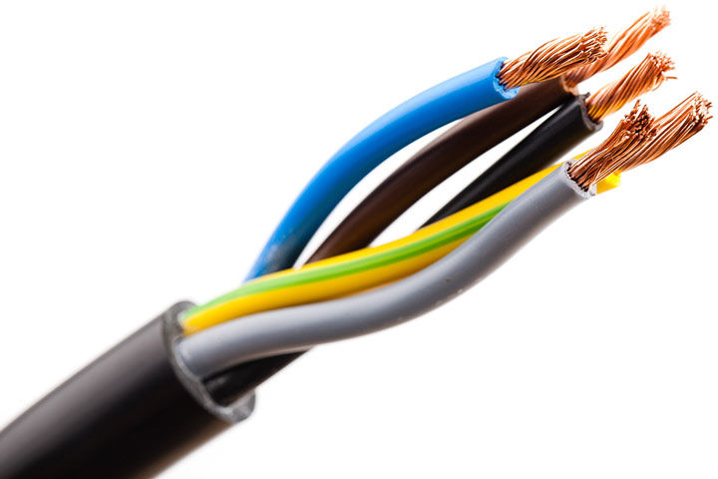
Conductors and insulators
A conductor is a material that allows the flow of electricity to pass through it.
An insulator is a material that does not allow the flow of electricity through it.
Conductors Insulators
* Metal * Styrofoam
* Water * Rubber
* Plastic
* Paper

Slide 6
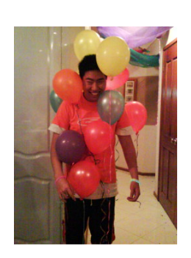
Charging Objects
Charging by Contact: the process of transferring charge by touching or rubbing
Charging by Induction: The rearrangement of electrons on a neutral object caused by a nearby charged object

Slide 8
Current
Is electricity that is caused by a continuous flow of electrons.
Electric current is measured in amperes.
The path that this current flows through is called a circuit.
A circuit must be closed to allow the flow of electricity.

Slide 9
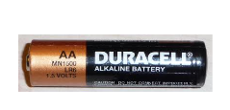
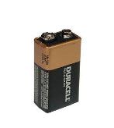
Voltage
Is the measure of energy given to the charge flowing in a circuit.
The greater the voltage, the greater the force or "pressure" that drives the charge through the circuit.
What is the difference between Volts and Amps?
* Amps measure like how much water comes out of a hose.
* Volts measure like how hard the water comes out of a hose.

Slide 10
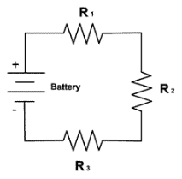
Resistance
Resistance is the tendency for a material to oppose the flow of electrons.
It changes electrical energy into thermal energy and light
All materials have some electrical resistance
Resistance is measured in ohms
Good conductors have low resistance.

Slide 11
Ohm’s Law
Simple circuits contain a source of voltage difference (like a battery), a device that has resistance (like a lightbulb), and conductors that connect everything together (wires).
The voltage difference, current, and resistance in a circuit are related. This relationship is known as Ohm's Law.
What current flows through a hair dryer plugged into a 110 Volt circuit if it has a resistance of 25 ohms?

Slide 12
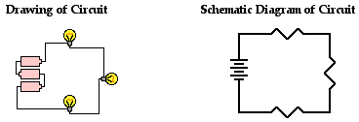
Circuit Symbols

Slide 13
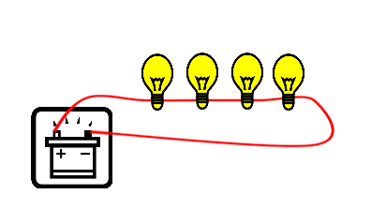
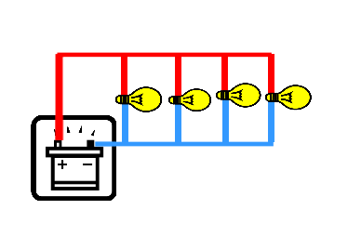
Types of Circuits
1. Series Circuit - the components are lined up along one path. If the circuit is broken, all components turn off.
2. Parallel Circuit - there are several branching paths to the components. If the circuit is broken at any one branch, only the components on that branch will turn off.

Slide 14
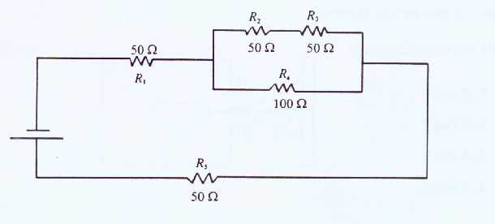
What type of circuit is this?

